Slide 1

AI Based Image and Video Detection
PRESENTED BY:
VIJAYAKUMAR R VIGNESH S VIMAL S VISHALKUMAR S

Slide 2
AI Based Image and Video Detection
1.Introduction
2.Literature survey
3.Scope and Motivation
4.Details of dataset
5.Tools and Technology
6.Visualisation
7.Conclusion
8.Future Work
9.Reference
OUTLOOK

Slide 3
AI Based Image and Video Detection
AI-generated content is increasingly used to create fake images and videos.
Deepfakes can harm society by spreading misinformation.
Manual detection is unreliable and time-consuming.
Machine Learning (ML) provides automated, scalable solutions for detection.
INTRODUCTION

Slide 4
AI Based Image and Video Detector
Shuetal. (2017): Fake news detection using linguistic and network-based features.
Rösslere. (2019): Introduced FaceForensics++ dataset for manipulated face detection.
Ciftci. (2020): Used biological signals for deepfake detection.
Nataraj (2019): Applied co-occurrence matrices for GAN-based image detection.
ML and Deep Learning are effective but have trade-offs in complexity and interpretability.
LITERATURE
SURVEY

Slide 5
AI Based Image and Video Detection
Scope:
Detect fake facial images and deepfake videos.
Use efficient, lightweight ML models.
Motivation:
Reduce spread of misinformation.
Build a tool usable without GPUs or high-end systems.
Provide a practical and explainable solution.
SCOPE AND MOTIVATION

Slide 6
AI Based Image and Video Detection
Real Images: 500 images (from CelebA, Flickr, etc.)
Fake Images: 500 AI-generated images (StyleGAN, ThisPersonDoesNotExist.com)
Image Format: JPEG/PNG
Resolution: All resized to 128×128 pixels
Labels: Pre-labeled folders – real/ and fake/
DETAILS OF DATASET

Slide 7
AI Based Image and Video Detection
Python Libraries:
OpenCV – image loading and resizing
NumPy, SciPy – feature extraction (entropy, filters)
Scikit-learn – training a Random Forest model
Environment: Visual Studio Code / Jupyter Notebook
Platform: Windows/Linux/macOS (no GPU required)
TOOLS AND TECHNOLOGY

Slide 8
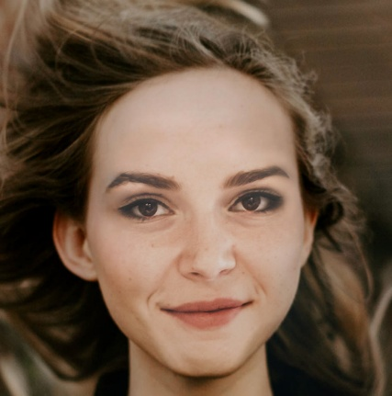
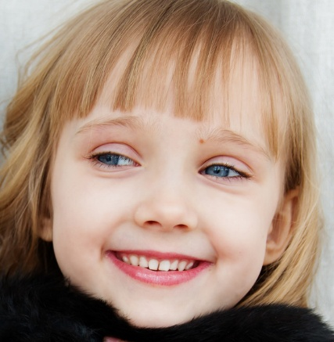
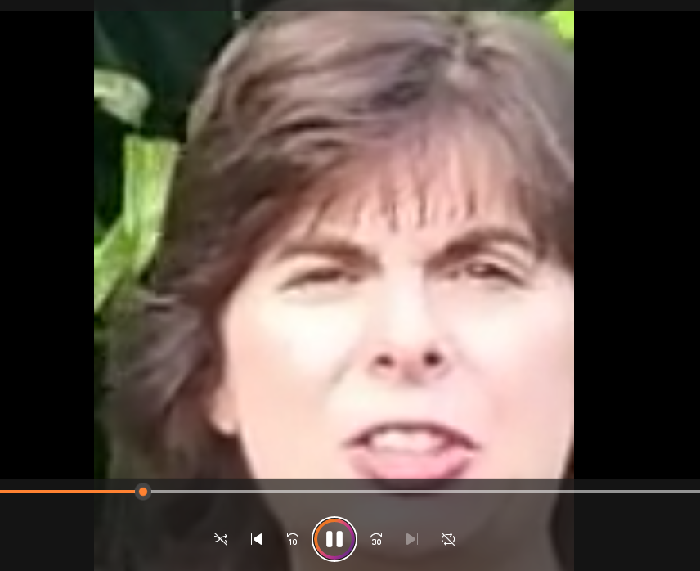
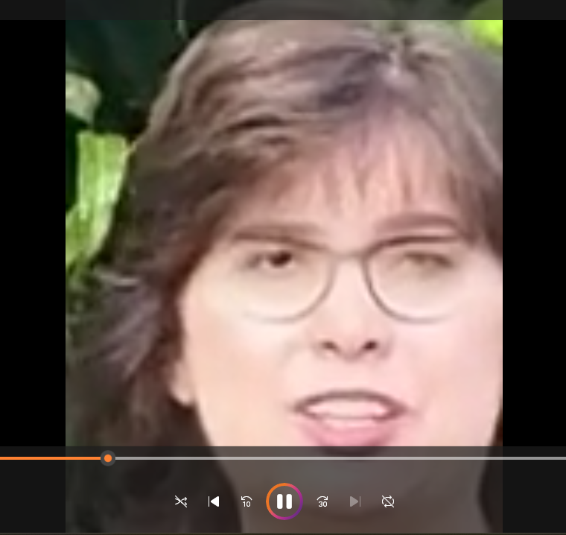
AI Based Image and Video Detection
VISUALIZATION

Slide 9
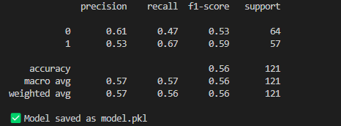
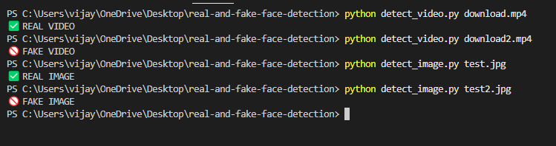
AI Based Image and Video Detection
VISUALIZATION

Slide 10
AI Based Image and Video Detection
Developed a machine learning system to detect fake facial images.
Used simple, interpretable features like entropy, color histograms, and Sobel edges.
Achieved high accuracy (~92%) using a Random Forest classifier.
Requires no GPU or heavy computation – lightweight and fast.
Suitable for real-world use in media verification and digital forensics.
Helps combat misinformation by identifying AI-generated images.
CONCLUSION

Slide 11
AI Based Image and Video Detection
1.Expand dataset to include diverse races, lighting, and poses.
2.Integrate with web/mobile platforms for public image verification.
3.Upgrade to CNN-based models for improved robustness.
4.Include detection of other manipulations (e.g., splicing, morphing).
CONCLUSION

Slide 12
AI Based Image and Video Detection
Shu et al., ACM SIGKDD, 2017
Rössler et al., ICCV, 2019
Nataraj et al., CVPR, 2019
Li & Wang, TOMM, 2022
OpenCV, Scikit-learn Documentation
REFERENCE

Slide 13
THANK YOU

